Slide 1
Using the Knowledge Expression and Reasoning method to solve the problems in Formal Verification
Renyan Feng
Guizhou University
Authors: Renyan Feng, Yisong Wang, Fangzhen Lin

Slide 2
Overview
Motivation
CTL
Finished work
Forgetting in bounded CTL (accepted by KR 2020)
A Resolution-based method in CTL (submited in AAAI 2021)
To do
Impliment the Resolution-based method to compute the forgetting in CTL
Solve a problem in Verification with the above system
Schedule
Thanks

Slide 3
Motivation
Removing the obsolete imformation without altering the relevant system behaviour:
Compute the Strongest Necessary Condition (SNC) and the Weakest Sufficient Condition (WSC) of a specification under a given Transition system and over a given signature.

Slide 4
CTL
Stands for Computation Tree Logic
Consider this Kripke structure (labeling omitted) :
the computation tree of 0 with depth 2:
M1 :
0
0
depth:0
depth:1
0
1
2
0
1
2
. . .
1

Slide 5
CTL
We have path quantifiers :
A ... : holds for all path (starting at the tree’s root)
E ... : holds for some path
Temporal operators :
X ... : holds next time
F ... : holds in the future
G ... : always hold
U : until
ϕ ::= p // atomic (state) proposition: Prop | ¬ϕ | ϕ₁ ∧ ϕ₂ | EX ϕ | EG ϕ | E(ϕ₁ U ϕ₂)
Notes:
M would only have one computation tree if it only has 1x innitial states; else it can have multiple comp. trees. Of course, each computation tree can be inifitely deep.

Slide 6
Semantics
: transition relation : label function
S: a finite set of states
s₀: an initial state in S
Let M = ( S, R, L, s₀) be an initial structure ☺
We call (M,t) a K-structure, and if t is a initial state, then (M,t) is an initial K-structure.
(M,t) ⊨ ϕ ϕ holds on the sate t
Which is recursively defined as follows:
(M,t) ⊨ p iff p ∈ L(t)
(M,t) ⊨ ¬ϕ iff not ( (M,t) ⊨ ϕ )
(M,t) ⊨ ϕ∧ψ iff (M,t) ⊨ ϕ and (M,t) ⊨ ψ
is a Kripke structure (S,R,L) with initial state s₀

Slide 7
(M,t) ⊨ EXϕ iff ( ∃(t,v)∈ R :: (M,v) ⊨ ϕ )
(M,t) ⊨ EGϕ iff
There is a path σ=(t₀=t, t₁,...) in M, starting at t such that:
For all i≥0, (M, t_{i})⊨ ϕ
(M,t) ⊨ E[ ψ U ϕ ] iff There is a path σ=(t₀=t, t₁,...) in M, starting at t such that:
For some i≥0, (M, t_{i} )⊨ ϕ
For all previous j, 0≤j<i, (M, t_{j} )⊨ ψ

Slide 8
Forgetting in bounded CTL (accepted by KR 2020)

Slide 9
Bounded CTL
The size of CTL formula is bounded to n.
It will be sufficient to consider the models of formulas within a state space S satisfying .

Slide 10
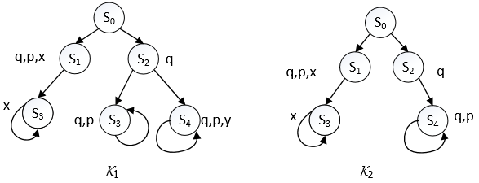
V-bisimilar
Two V-bisimilar initial K-structures, V={y}.
P={p,q,x,y}
{y}-bisimilar
We use these V-bisimulation also for computation trees.
They are behaviourally the same on P\{y}.

Slide 11
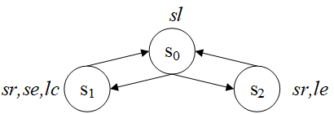

Example
Two states s and s' in M are V-distinguishable, if there exists
a least constant k such that , denoted as

Slide 12
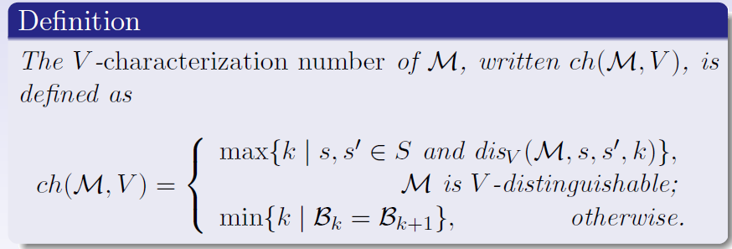
V -characterization number
We can see that ch(M,V) always exists for every initial structure M and V.

Slide 13
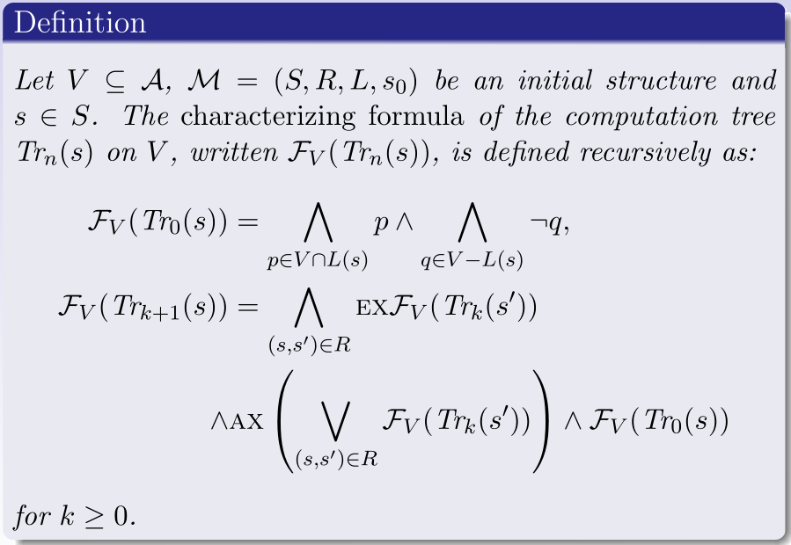
Characterizing formula - computation tree

Slide 14
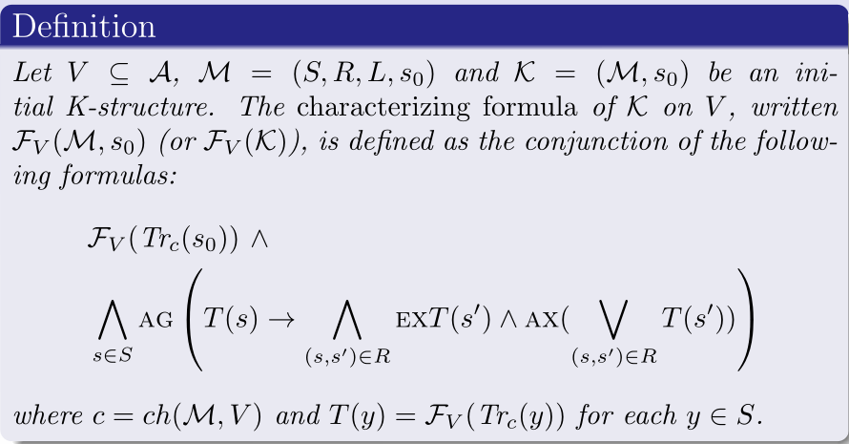
Characterizing formula - initial K-structure

Slide 15
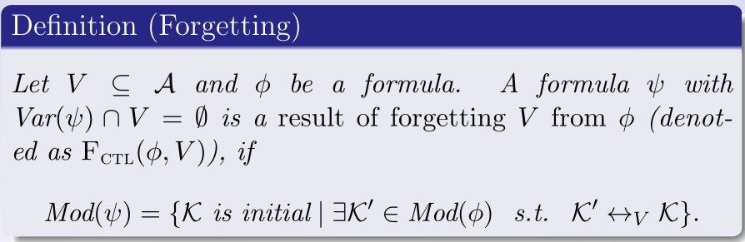

Forgetting
Such a formula always exists, which is equivalent to

Slide 16
SNC and WSC
Two logical notions introduced by the Dutch computer scientist Edgar Dijkstra are informative:
Strongest Necessary Condition (SNC) is the most general consequence；and
Weakest Sufficient Condition (WSC) is the most specific abduction

Slide 17
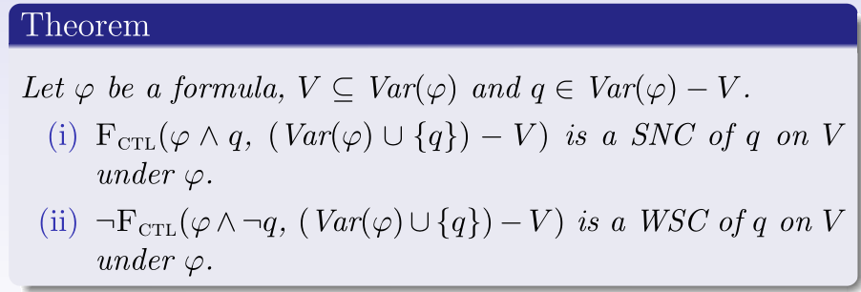
The relationship - SNC (WSC) and Forgetting
Dual
SNC
WSC

Slide 18
Contributions
A Forgetting framework for CTL
Representation Theorem
Complexity results
Algebraic Properties of the Forgetting operator: Homogeneity, Commutativity, and others
Computing SNC and WSC by using Forgetting in CTL

Slide 19
A Resolution-based method in CTL
“（submitted in AAAI 2021)”

Slide 20
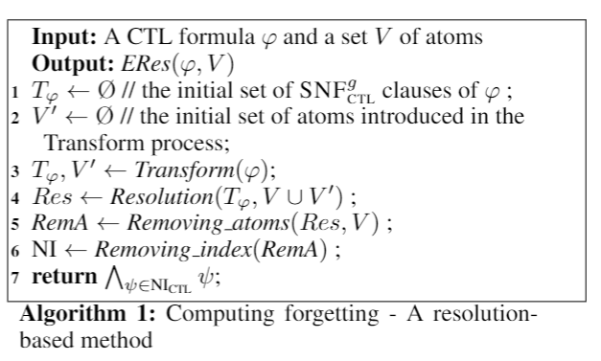
Algorithm
Extend the resolution method of Zhang at al.
new atoms

Slide 21
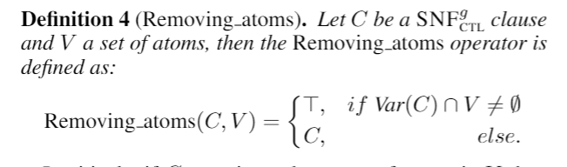
Eliminate operator in V

Slide 22
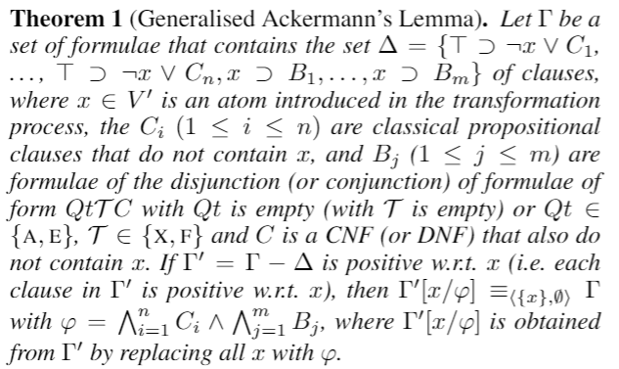
Generalised Ackermann's Lemma
To eliminate the new atoms introduced in the Transform process.

Slide 23
To do

Slide 24
To do
Construct a system to compute the CTL with Prolog
Solve a problem in Verification with our system.....

Slide 25
Schedule
Construct a system in 6 months
Find a good Example of Verification to use our system in 1 to 2 months
Use our system to solve the above Example.

Slide 26
Thanks!
Questions

